Slide 1


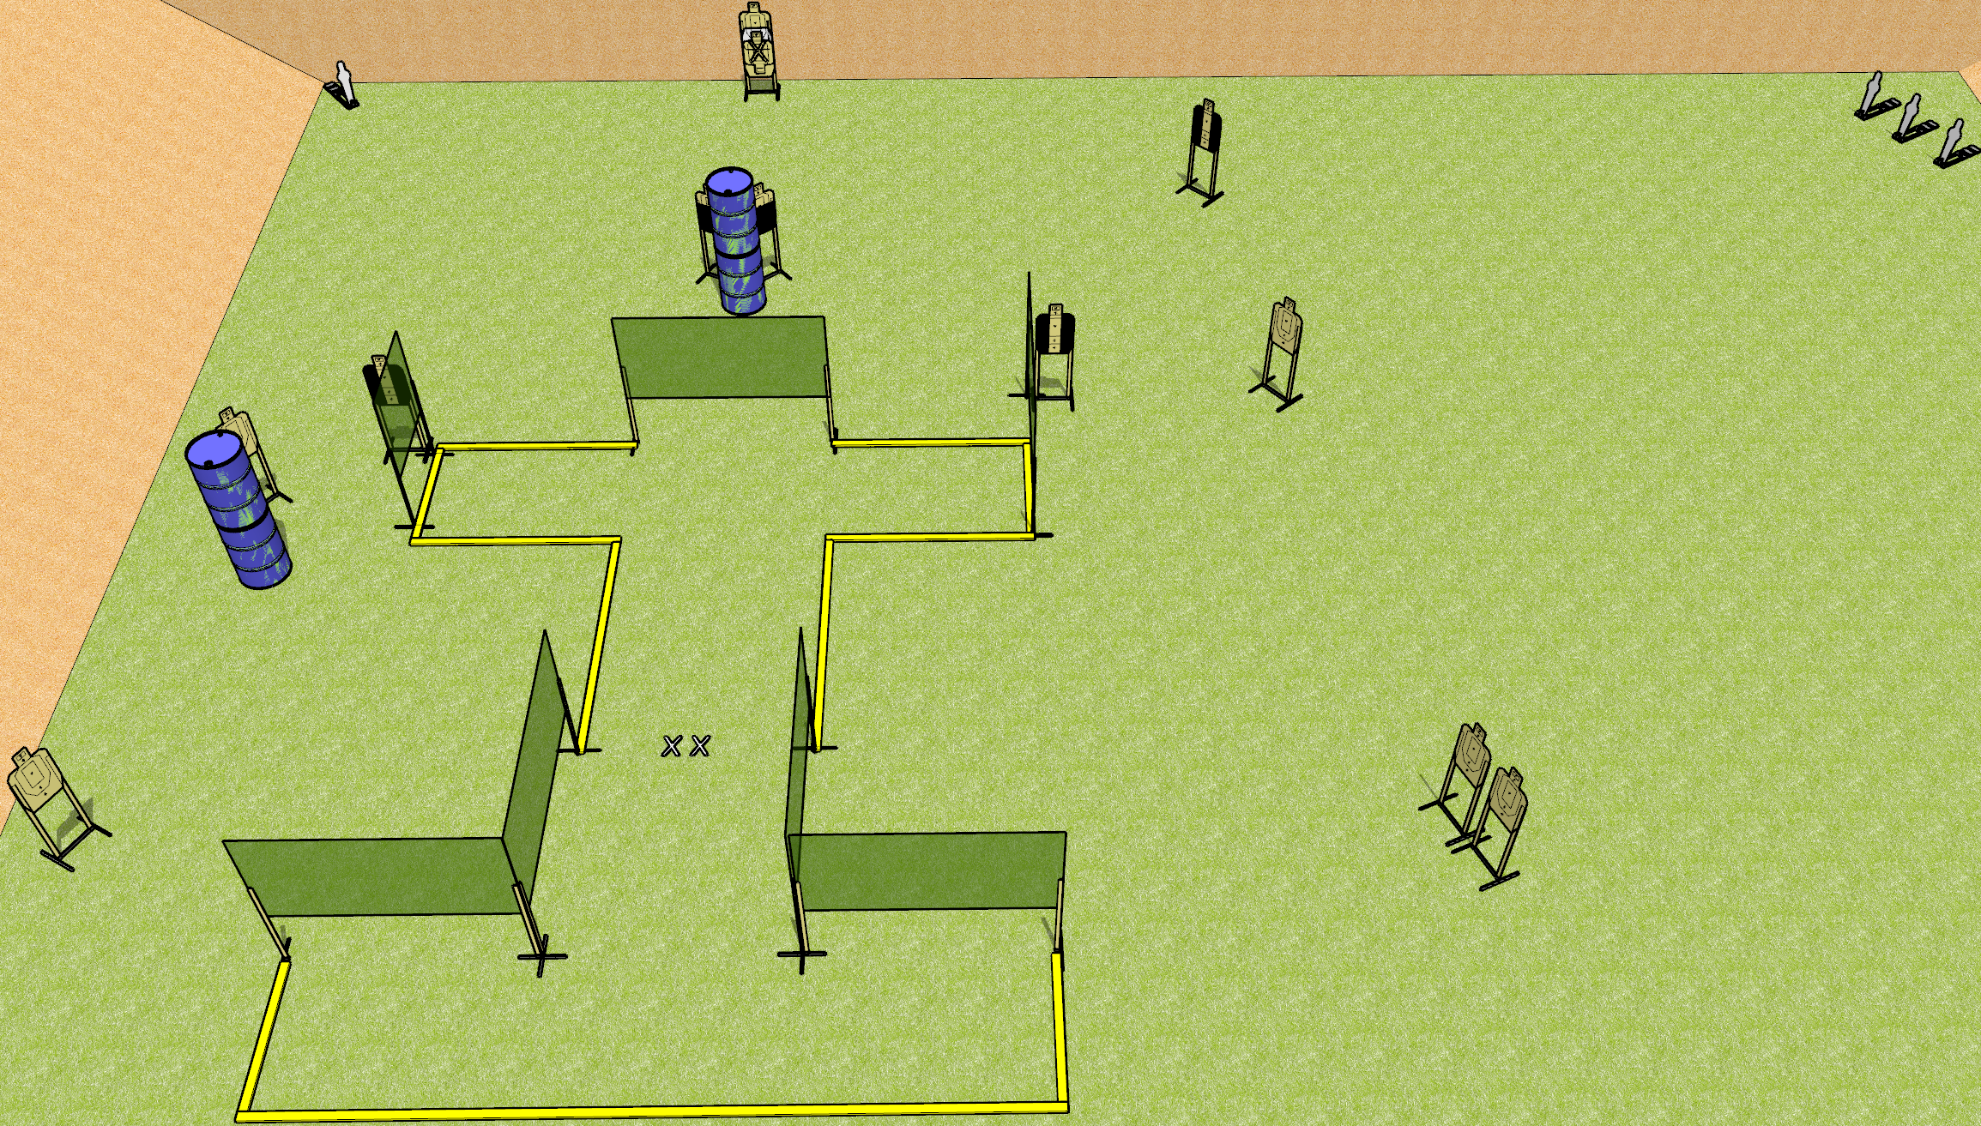
 | Dothan Gun Club – USPSA Match I Beam Course Designer : Drew Coleman
28 rounds 12 USPSA targets 4 USPSA mini poppers
Equipment List 12 wall feet 3 tuxedos, 2 50% OR use diagonal Target as the back is 2 stacked with NS

Slide 2
I Beam
Written Stage Briefing
I Beam is a 28 round, 140 point, Comstock field course. There are 12 USPSA targets and 4 USPSA mini poppers. The best two hits on paper will score, and steel must fall to score. The start signal is audible.
Handgun start position is both feet on X’s, wrists below belt. Handgun is loaded and holstered.
PCC start position is both feet on X’s. Loaded carbine is held with both hands, stock on belt, safety on.
On start signal, engage targets as they become available from within the shooting area.

